Slide 1
Neural Networks
Single Layer
Single Neuron
Multiple Layers
Input and Output

Slide 2
What does a single Neural Network Layer do ?
F( Wx + b )

Slide 3
What does a single Neural Network Layer do ?
2 | 4 | 2
1 | 3 | 7
0 | 7 | 3
1
3
2
18
24
27

Slide 4
What does a single Neural Network Layer do
18
24
27
-3
0
2
+

Slide 5
What does a single Neural Network Layer do
18
24
27
-3
0
2
F
+

Slide 6
What does a single Neural Network Layer do
18
24
27
-3
0
2
F
+
Activation Function

Slide 7
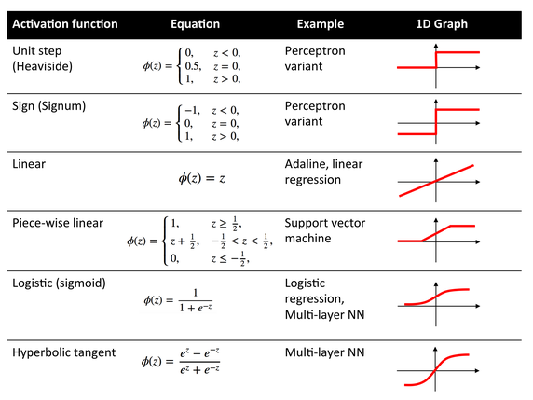
https://en.wikipedia.org/wiki/Activation_function

Slide 8
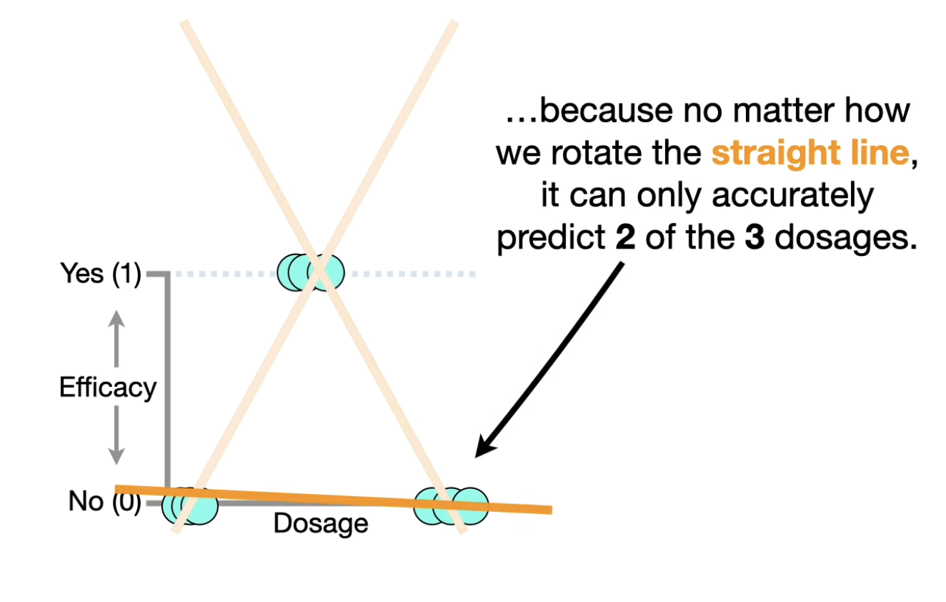

Slide 9
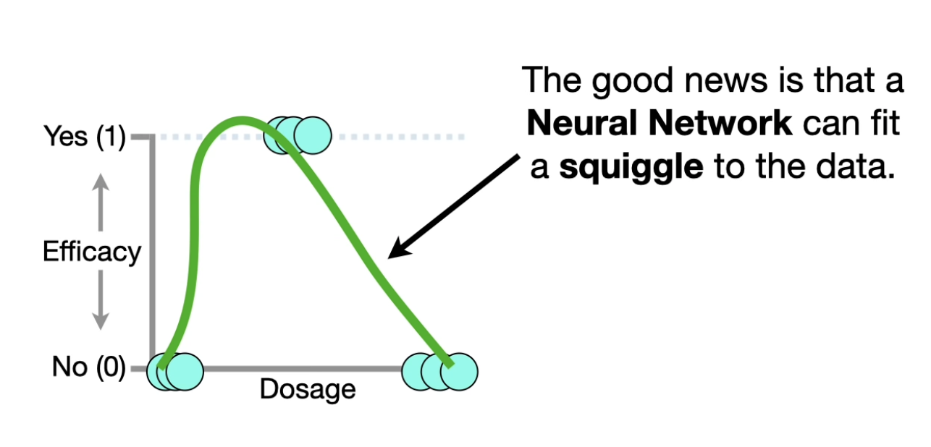

Slide 10
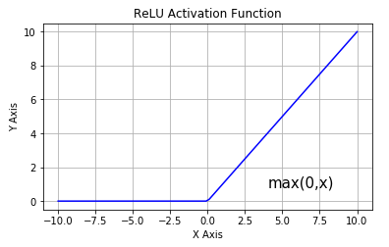
ReLU Activation function
It stands for Rectified Linear Unit
ReLU(x) = max(x,0)

Slide 11
What does a single Neural Network Layer do
18
24
27
-3
0
2
F(15)
F(24)
F(29)
F
+

Slide 12
What does a single Neural Network Layer do ?
2 | 4 | 2
1 | 3 | 7
0 | 7 | 3
1
3
2
-3
0
2
F
+

Slide 13
What does a single Neural Network Layer do ?
2 | 4 | 2
1 | 3 | 7
0 | 7 | 3
1
3
2
-3
0
2
F
+
Weight Matrix

Slide 14
What does a single Neural Network Layer do ?
2 | 4 | 2
1 | 3 | 7
0 | 7 | 3
1
3
2
-3
0
2
F
+
Input Vector

Slide 15
What does a single Neural Network Layer do ?
2 | 4 | 2
1 | 3 | 7
0 | 7 | 3
1
3
2
-3
0
2
F
+
Bias Vector

Slide 16
What does a single Neural Network Layer do ?
2 | 4 | 2
1 | 3 | 7
0 | 7 | 3
1
3
2
-3
0
2
F
+
Trainable Parameters

Slide 17
What does a single Neural Network Layer do ?
F( Wx + b )

Slide 18
What does a single Neuron do ?
F( w₁^{T}x + b₁ )

Slide 19
What does a single Neural Network Layer do ?
F( Wx + b )

Slide 20
Weights for each neuron
2 | 4 | 2
1 | 3 | 7
0 | 7 | 3
w₁^{T}
w₂^{T}
w₃^{T}
W =
=

Slide 21
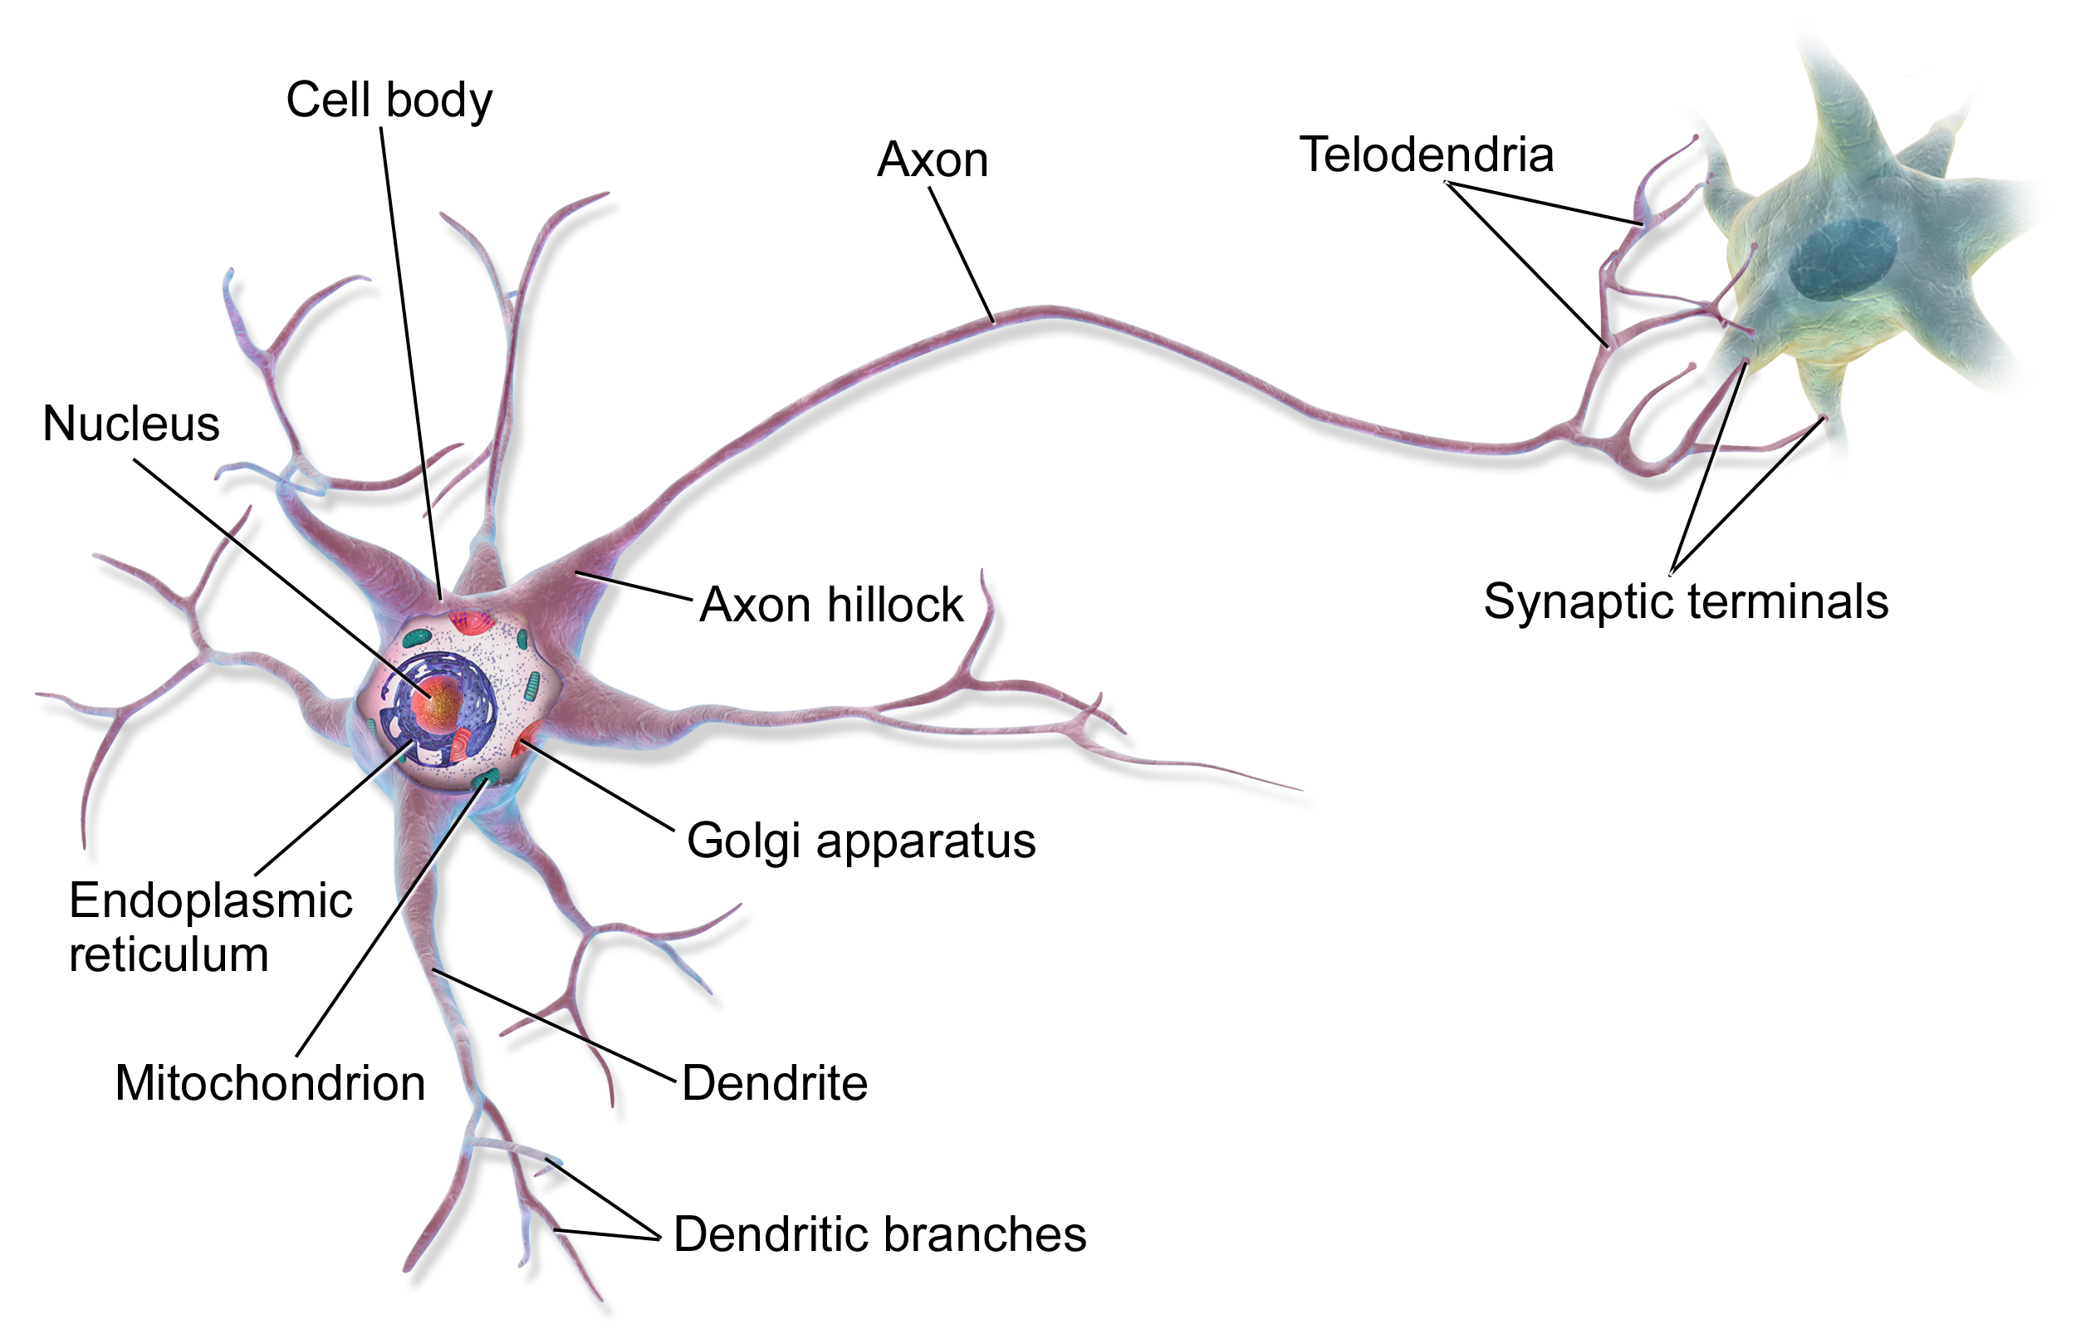
Why does it call Neuron?
F( w₁^{T}x + b₁ )
Playground

Slide 22
Stacking multiple layers
It’s called a deep neural network when you use multiple layers

Slide 23
What are the inputs and outputs?

Slide 24
What does the Hidden Layer do?
https://www.youtube.com/watch?v=aircAruvnKk&list=PLZHQObOWTQDNU6R1_67000Dx_ZCJB-3pi&index=2
3:39 -> 7:51

Slide 25

Gradient Descent
The Idea is to go downhill according to the linear approximation of your function
But not too much as your approximation will not be true
This means updating each weight in proportional to the gradient

Slide 26
Gradient Descent
The Idea is to go downhill according to the linear approximation of your function
But not too much as your approximation will not be true
This means updating each weight in proportional to the gradient
Learning Rate

Slide 27
How to compute gradients - Backpropagation
Numerically approximating gradients is too slow and computationally expensive
The neural network is a well defined mathematical function, we should be able to differentiate it and calculate the derivatives
This is also too tedious so we instead use an algorithm called backpropagation

Slide 28
Computational Graph
Consider this simple function, imagine that this is the cost function and we want to find the gradients with respect to the two weights
We will first build the computational graph that this function represents

Slide 29
Computational Graph
x₁
w₁
+
*
x₂
w₂
*
max
x₃

Slide 30
Computational Graph
x₁
*
w₁
+
F
x₂
max
*
x₃
w₂

Slide 31
Forward propagation
Key to remember: Transforming input X through a model with linear and non-linear transformation to get a output.
Each Circle represents a computational operation
Each arrow is an intermediate quantity that is computed
Each box contains some value
Orange boxes are inputs
Blue boxes are parameters
Compute the inputs to an operation first then apply the operation to compute its output

Slide 32
Forward propagation
3
+
7
4

Slide 33
Forward propagation
3
*
12
4

Slide 34
Forward propagation
x₁
2
*
w₁
6
3
+
F
x₂
4
max
1
*
4
-2
x₃
3
w₂
-2

Slide 35
Backward propagation
Key to remember: training networks based on current output and true Y, optimizing parameters to minimize loss
The numbers flow backwards along the arrows
At each arrow the quantity represents the gradient of some final function with respect to the quantity at that arrow

Slide 36



Backward propagation
2
2
3
+
2
7
4

Slide 37
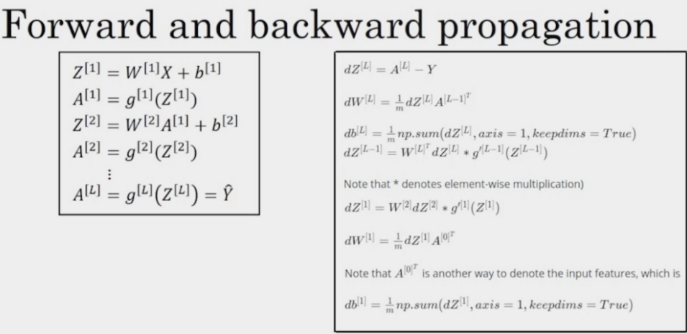
More algorithm in details => CS 230

Slide 38
Forward propagation
x₁
2
*
w₁
6
3
+
F
x₂
4
max
1
*
4
-2
x₃
3
w₂
-2

Slide 39
Backward propagation
3
x₁
2
*
2
1
w₁
6
3
+
1
1
F
x₂
-2
1
4
max
1
*
0
-2
4
1
x₃
3
w₂
-2

